Slide 1
Application Integration
(SQS, SNS, SWF, Step Functions)
AWS Certified Solutions Architect– Professional (SAP-C01) -
Study notes - Sep’2019

Slide 2
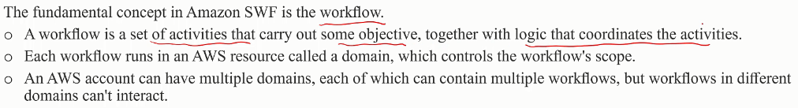
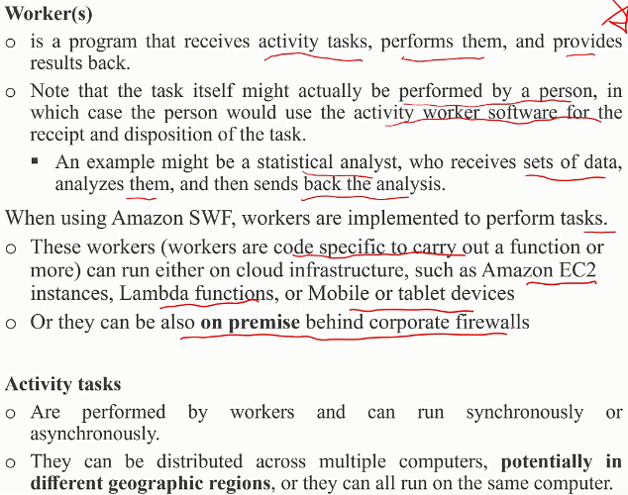
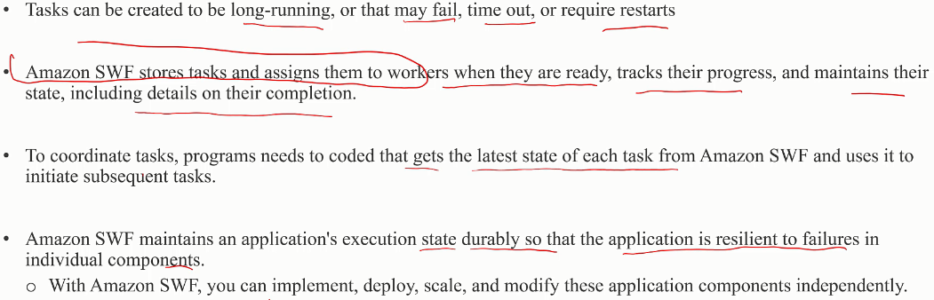
Simple Workflow Service (SWF)

Slide 3
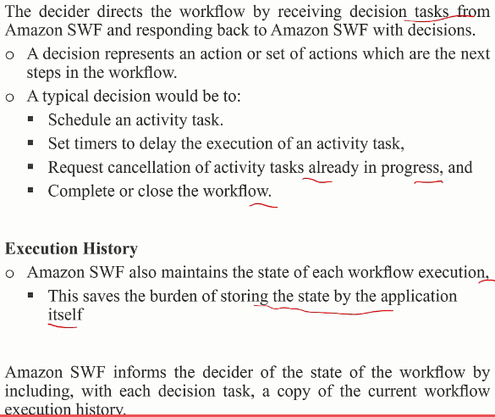
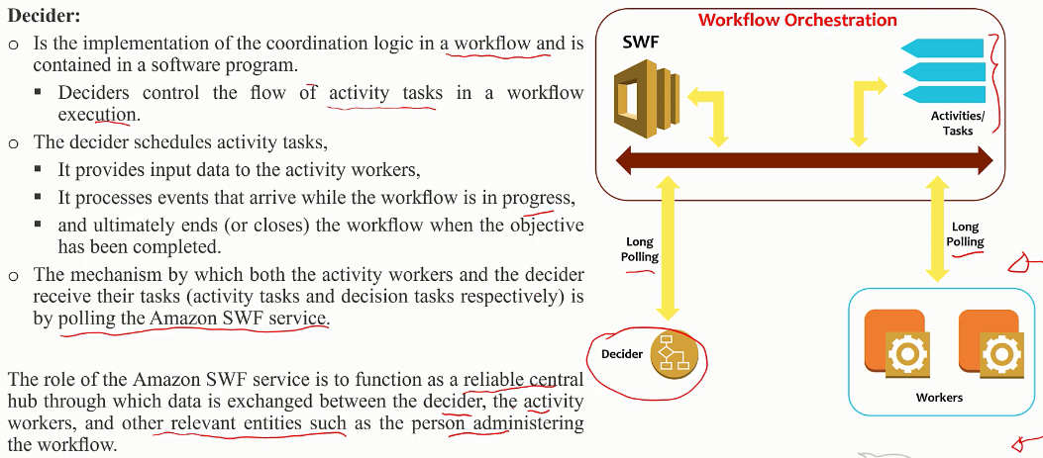
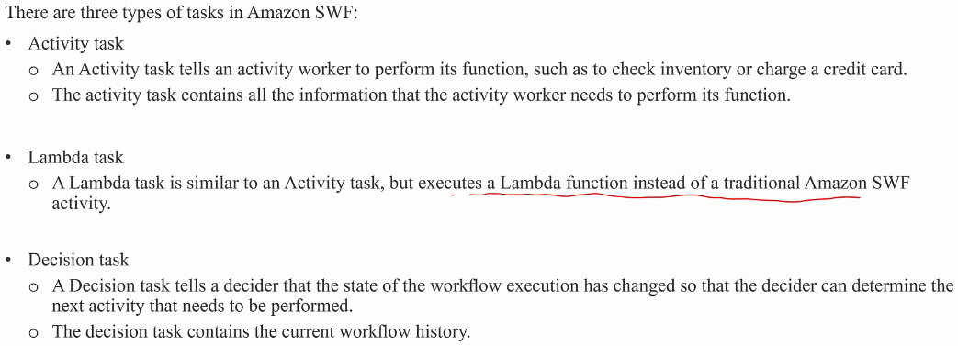
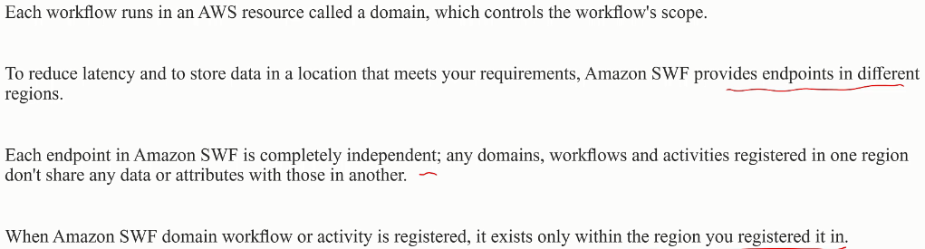
Simple Workflow Service (SWF)

Slide 4
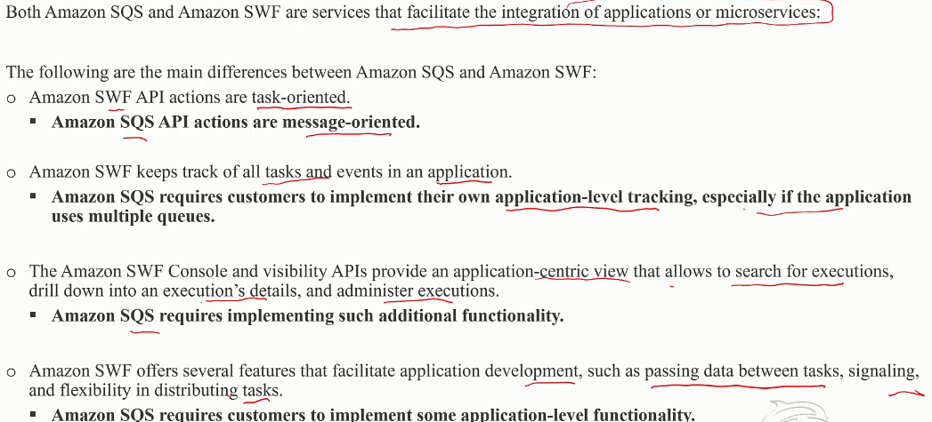
Simple Workflow Service (SWF) vs SQS

Slide 5
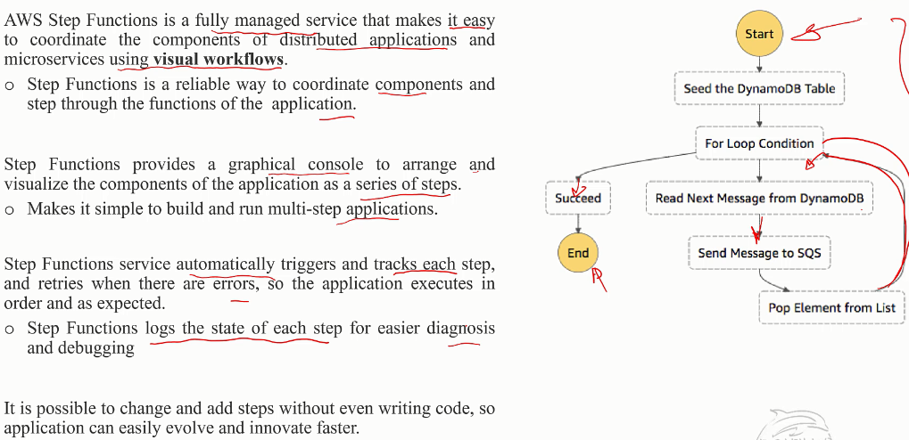
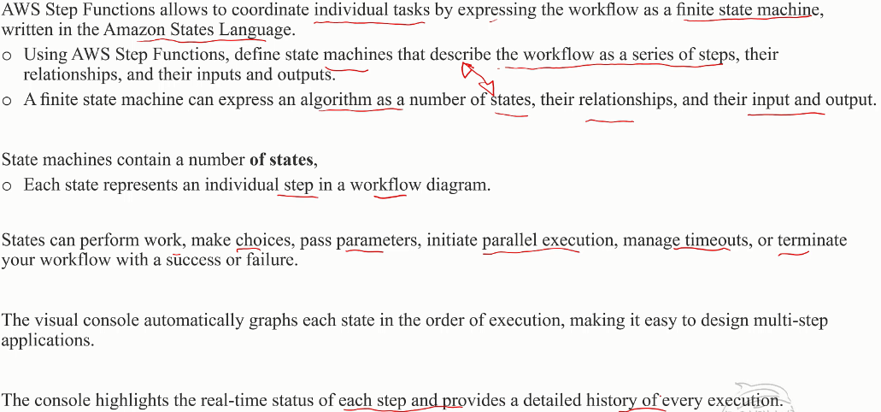
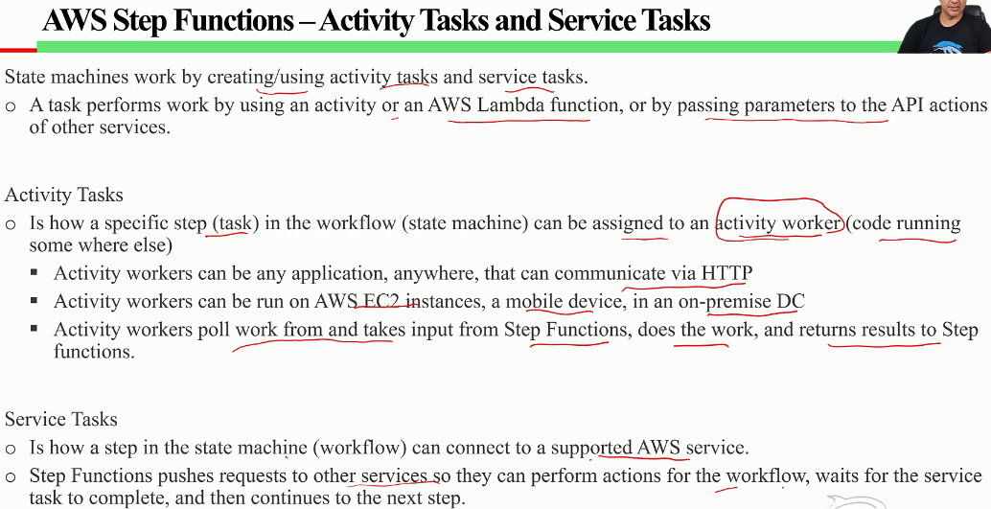
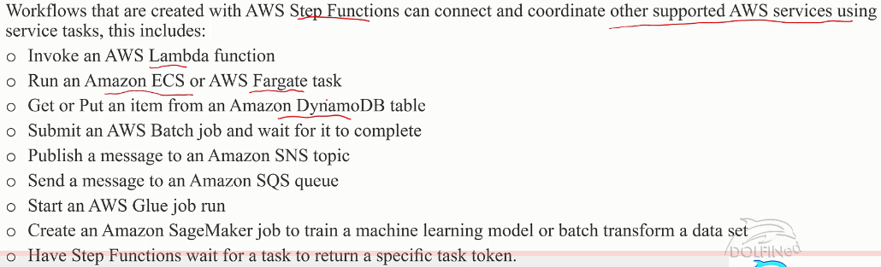
AWS Step Functions (enhanced version of SWF)

Slide 6
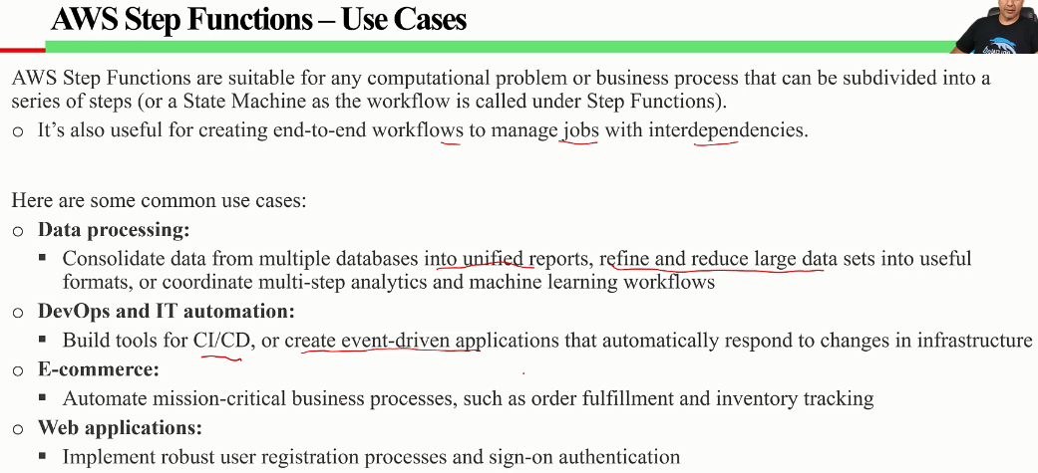
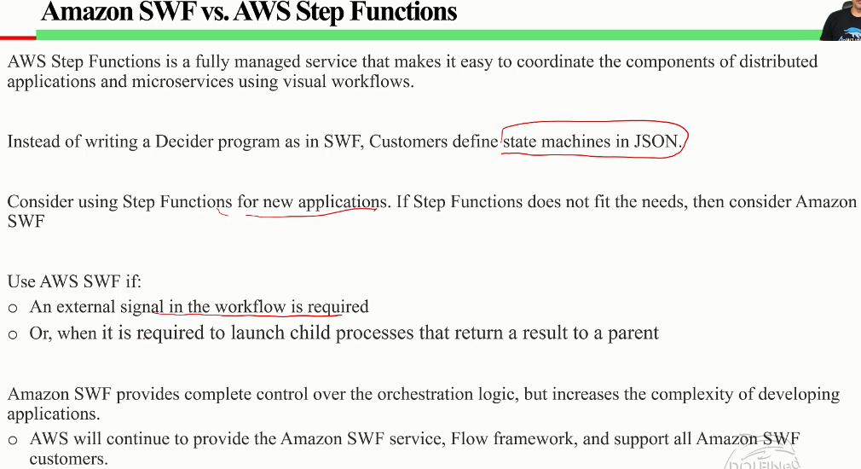
AWS Step Functions (enhanced version of SWF)

Slide 7
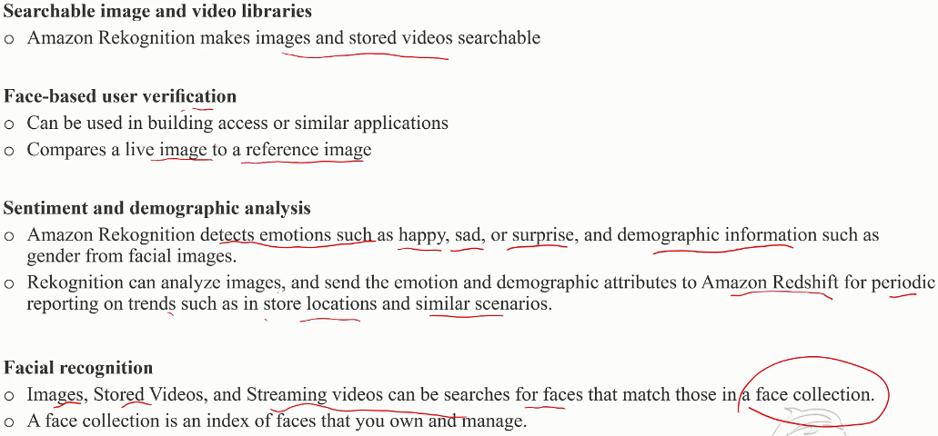
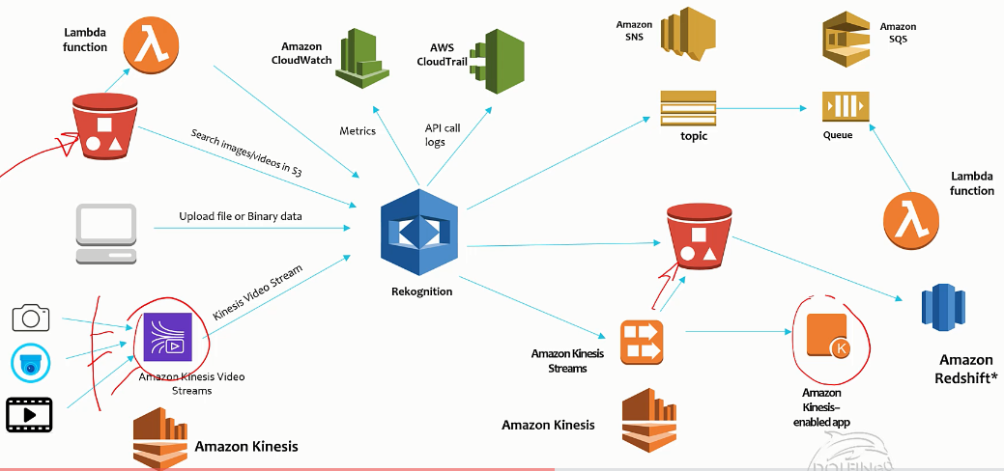
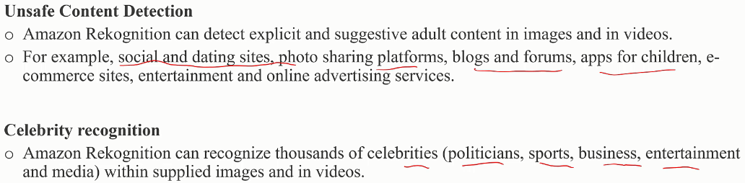
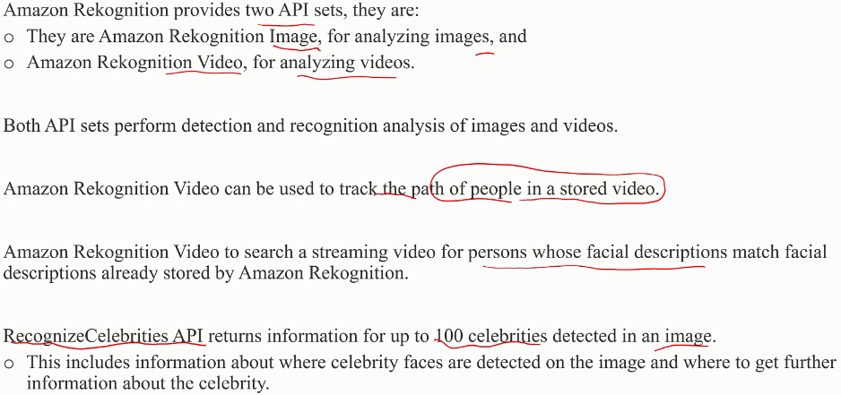
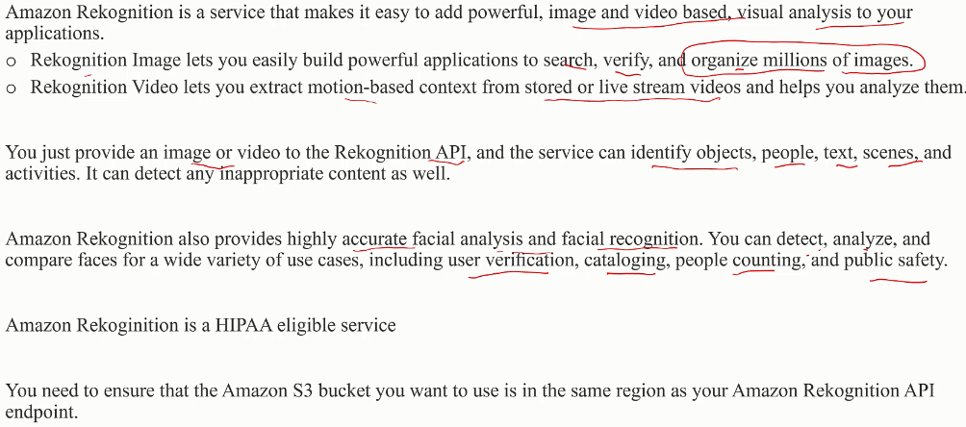
AWS Rekognition
Common use cases

Slide 8
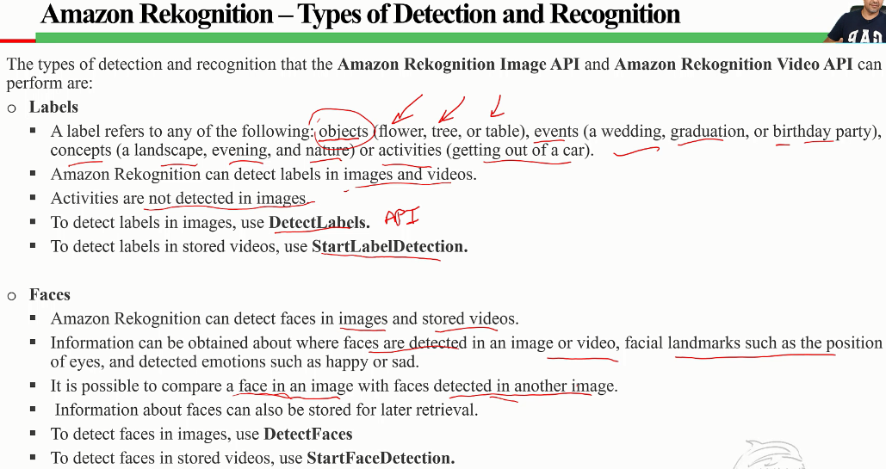
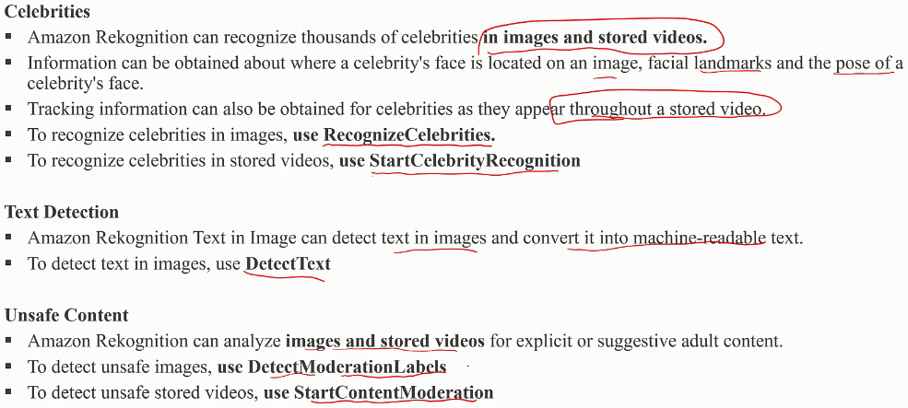
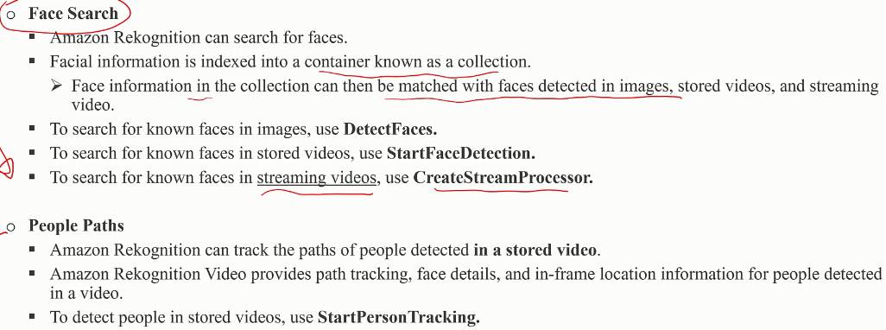
AWS Rekognition
Image (S3 or bytes) → DetectFaces() → Response in JSON
Stored video (S3) → StartFaceDetection() → Result to SNS topic
Streaming video (Kinesis Video stream) → CreateStreamProcessor() → Kinesis Data stream
Images | DetectLabels DetectFaces RecognizeCelebrities DetectText DetectModerationLabels
Stored Video | StartLabelDetection StartFaceDetection StartPersonTracking StartCelebrityRecognition StartContentModeration
Streaming Video | CreateStreamProcessor (face detection)

Slide 9
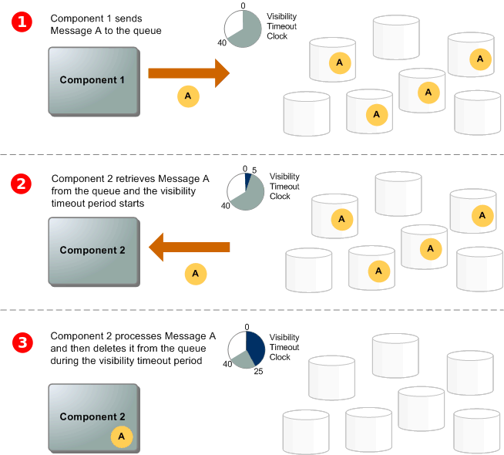
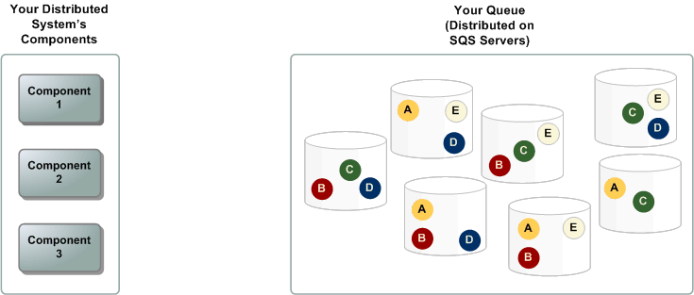
AWS SQS
Standard queues -
Order not maintained,
At least one delivery,
High throughput
FIFO queues
Message Order maintained (within message group and within 5-minute dedup interval),
Exact once delivery (No duplicates, provide msg dedup id)
Throughput limited (300 TPS per Api)
Messages are ordered based on message group ID. If multiple hosts (or different threads on the same host) send messages with the same message group ID to a FIFO queue, SQS stores the messages in the order in which they arrive for processing. To ensure that SQS preserves the order in which messages are sent and received, ensure that each producer uses a unique message group ID to send all its messages.

